Slide 1


Slide 2
CUDA: Introduction
Christian Trefftz / Greg Wolffe
Grand Valley State University
Supercomputing 2008
Education Program

Slide 3
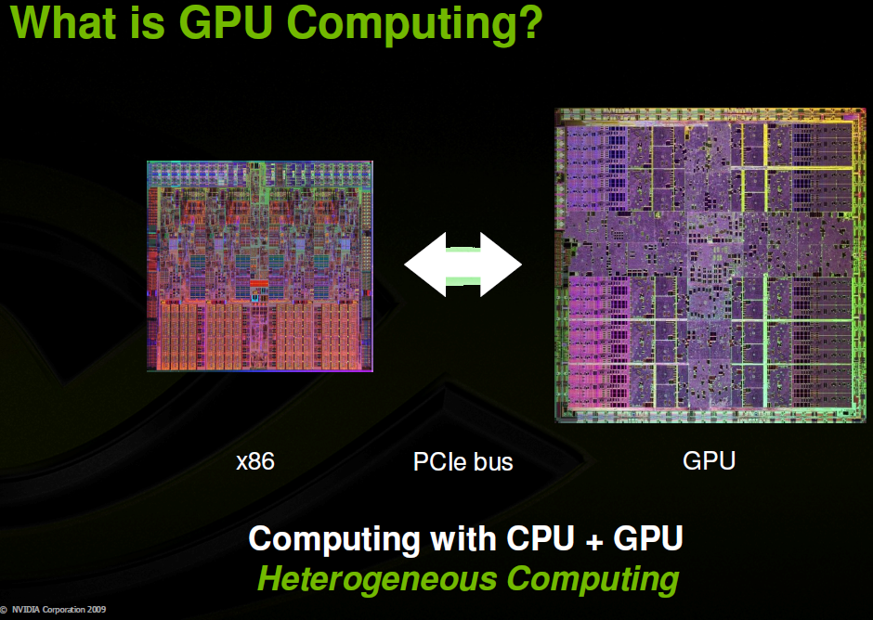

Slide 4
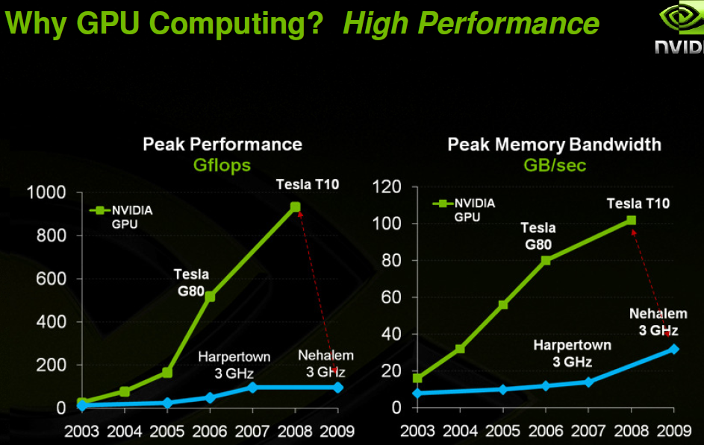

Slide 5
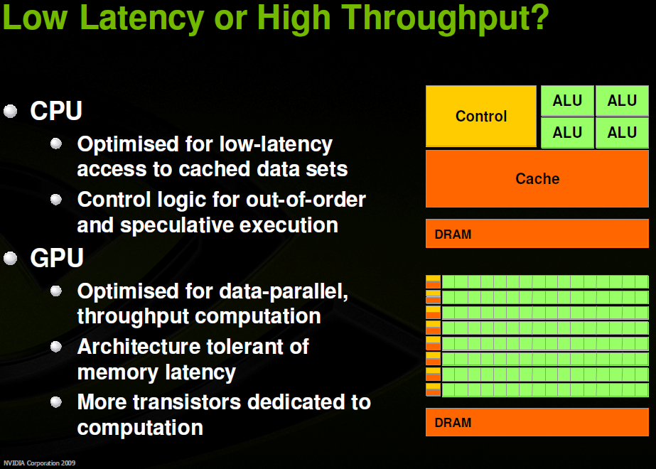

Slide 6
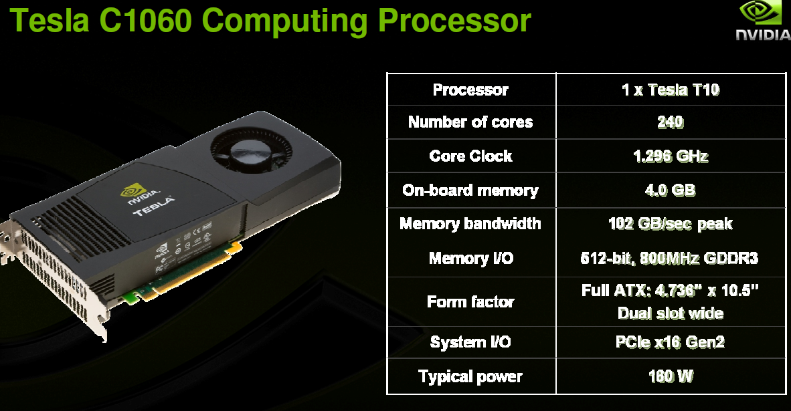

Slide 7
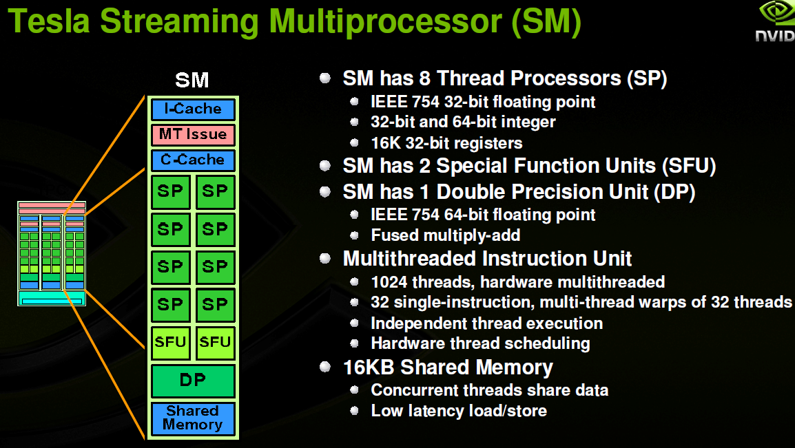

Slide 8
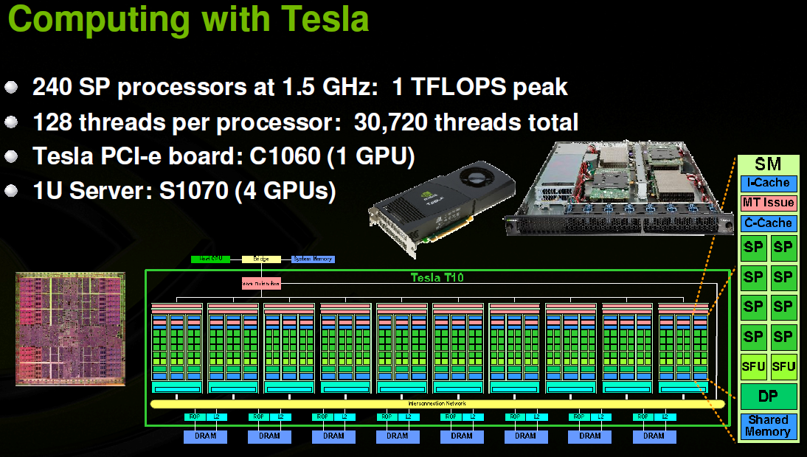

Slide 9
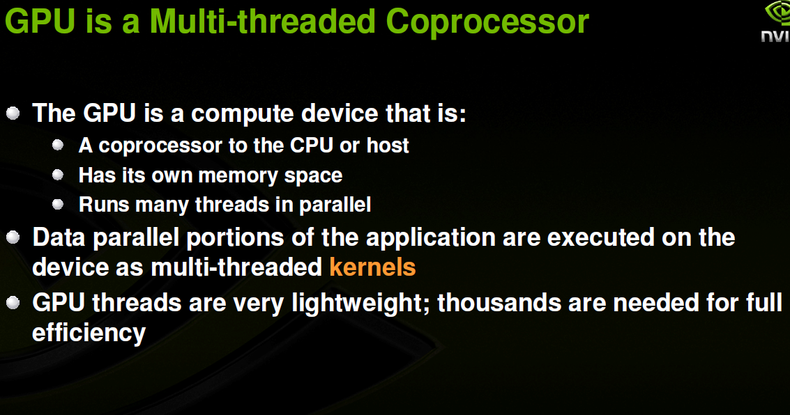

Slide 10
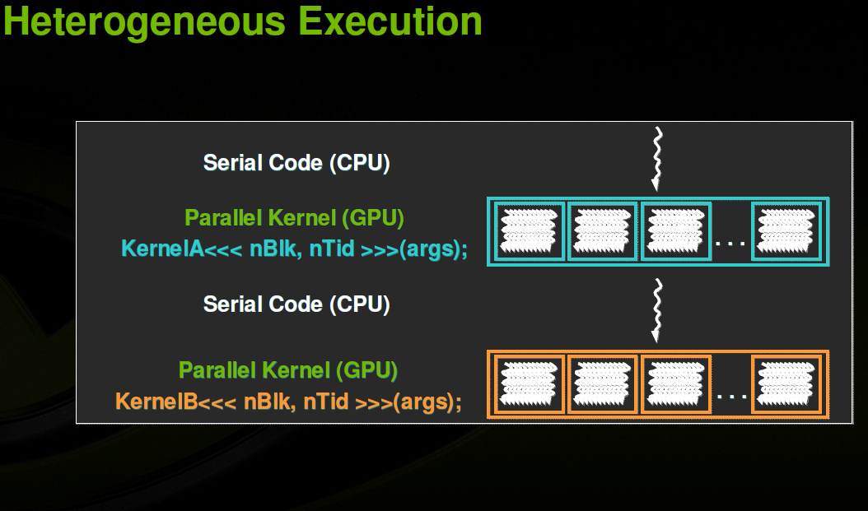

Slide 11
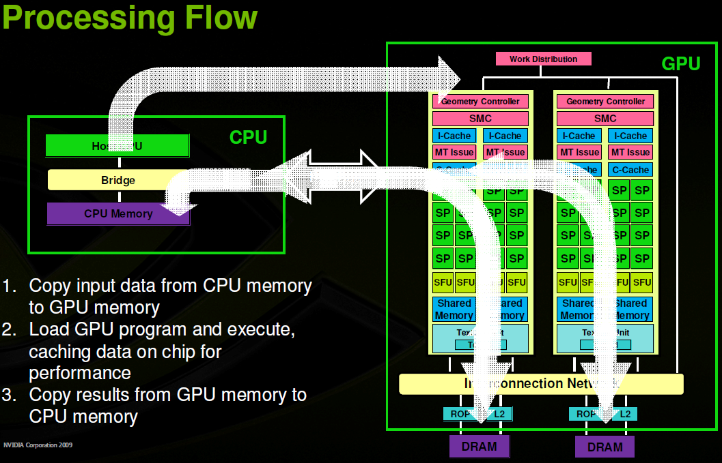

Slide 12
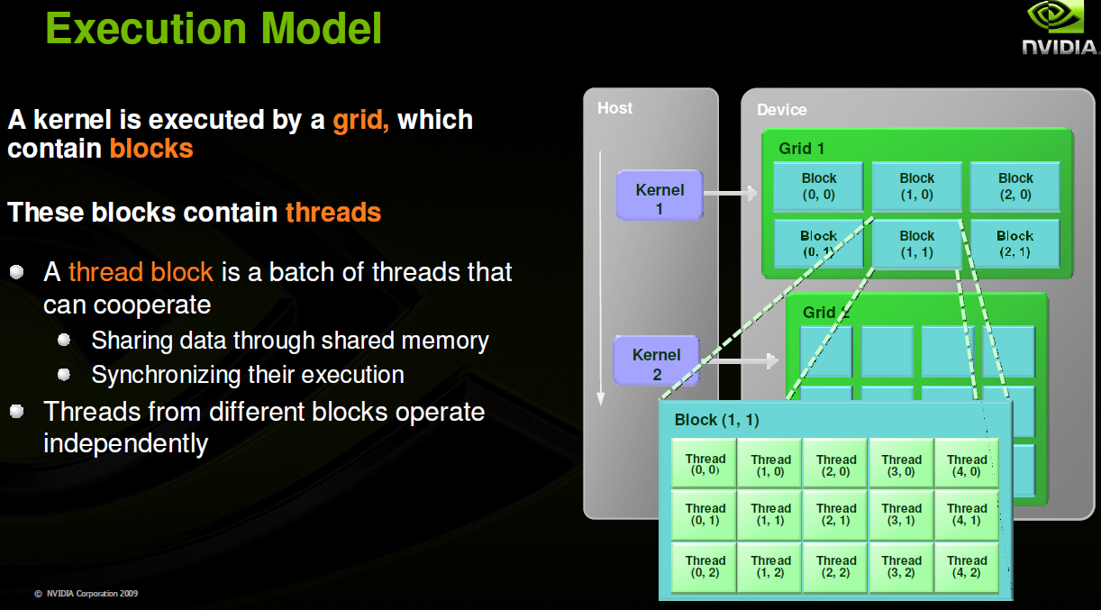

Slide 13
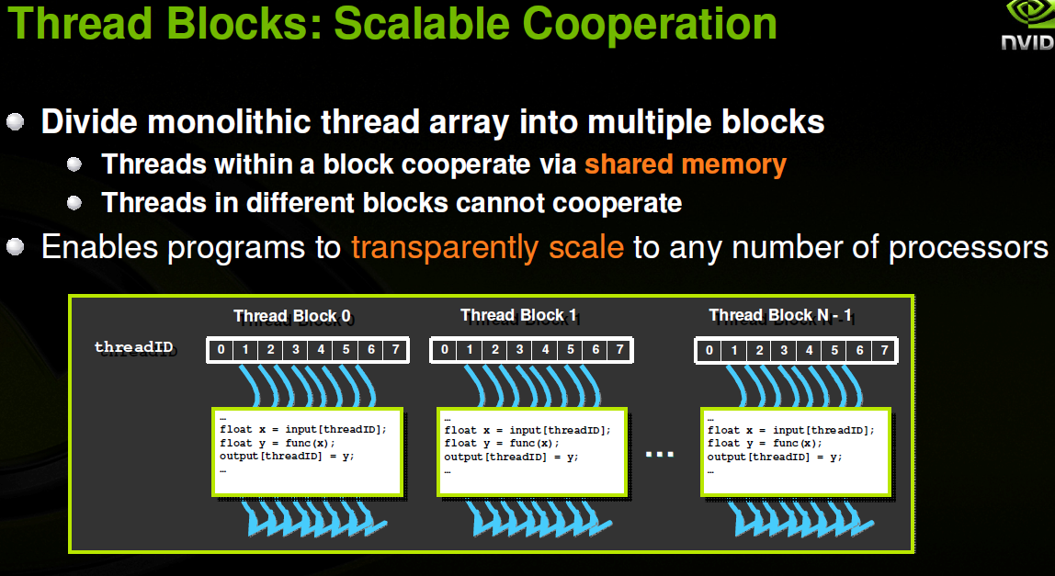

Slide 14
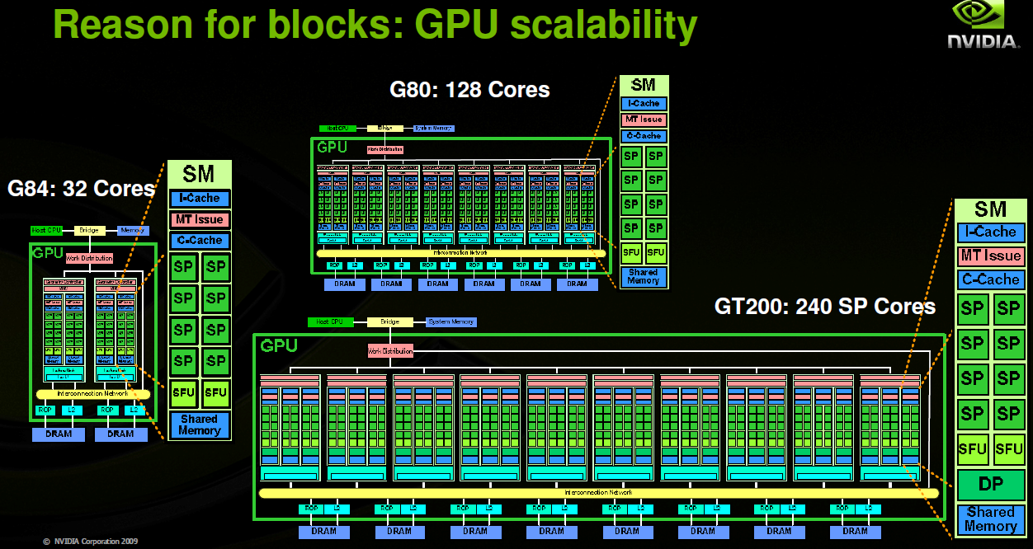

Slide 15
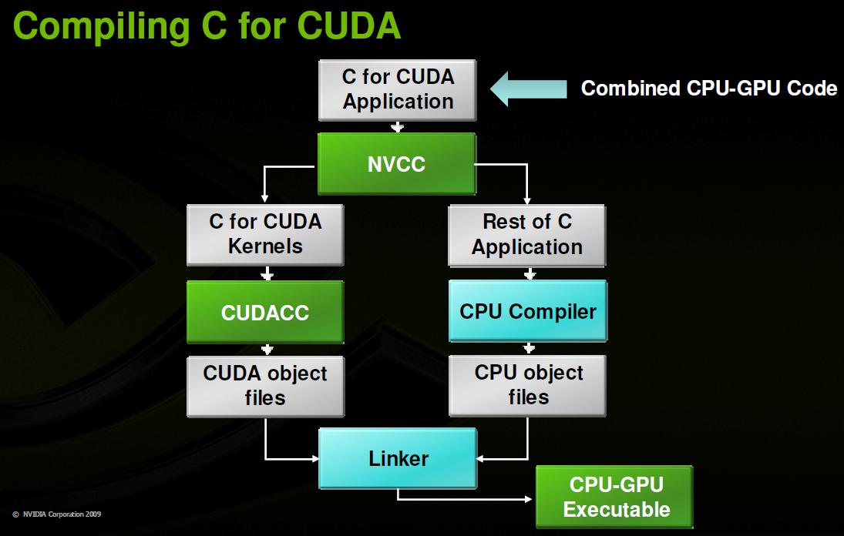

Slide 16
Terms
What is GPGPU?
General-Purpose computing on a Graphics Processing Unit
Using graphic hardware for non-graphic computations
What is CUDA?
Compute Unified Device Architecture
Software architecture for managing data-parallel programming

Slide 17
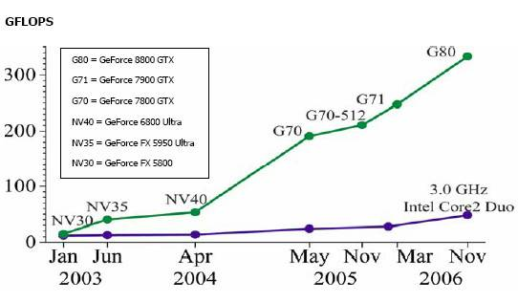
Motivation

Slide 18
CPU vs. GPU
CPU
Fast caches
Branching adaptability
High performance
GPU
Multiple ALUs
Fast onboard memory
High throughput on parallel tasks
Executes program on each fragment/vertex
CPUs are great for task parallelism
GPUs are great for data parallelism

Slide 19
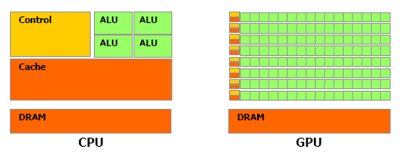
CPU vs. GPU - Hardware
More transistors devoted to data processing

Slide 20
Traditional Graphics Pipeline
Vertex processing
⇩
Rasterizer
⇩
Fragment processing
⇩
Renderer (textures)

Slide 21
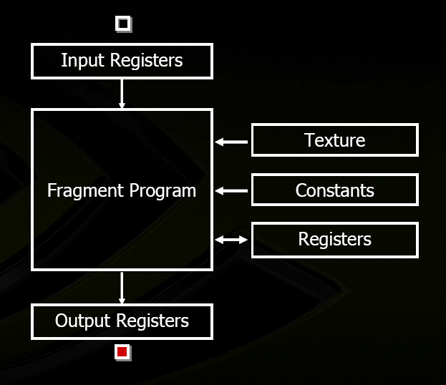
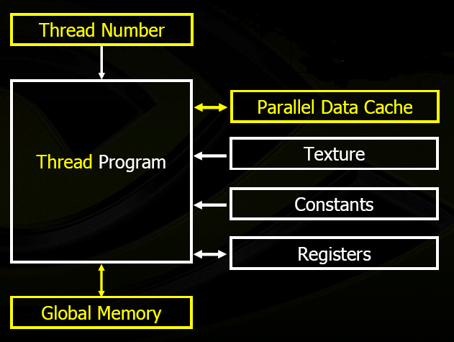
Pixel / Thread Processing

Slide 22
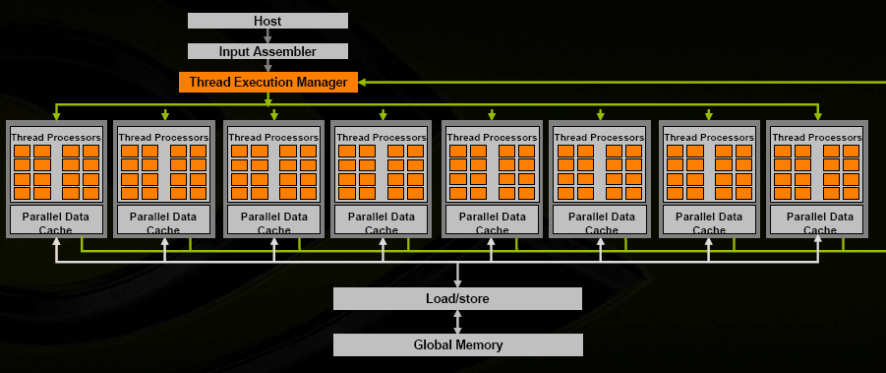
GPU Architecture

Slide 23
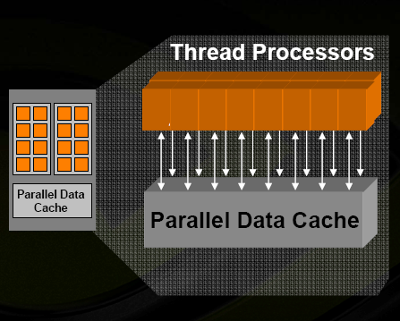
Processing Element
Processing element = thread processor = ALU

Slide 24
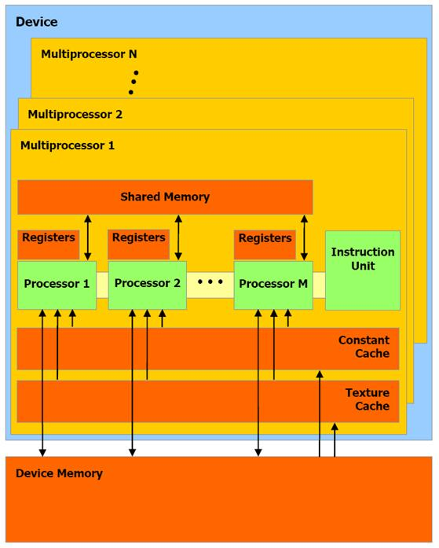
Memory Architecture
Constant Memory
Texture Memory
Device Memory

Slide 25
Data-parallel Programming
Think of the CPU as a massively-threaded co-processor
Write “kernel” functions that execute on the device -- processing multiple data elements in parallel
Keep it busy!  massive threading
Keep your data close!  local memory

Slide 26
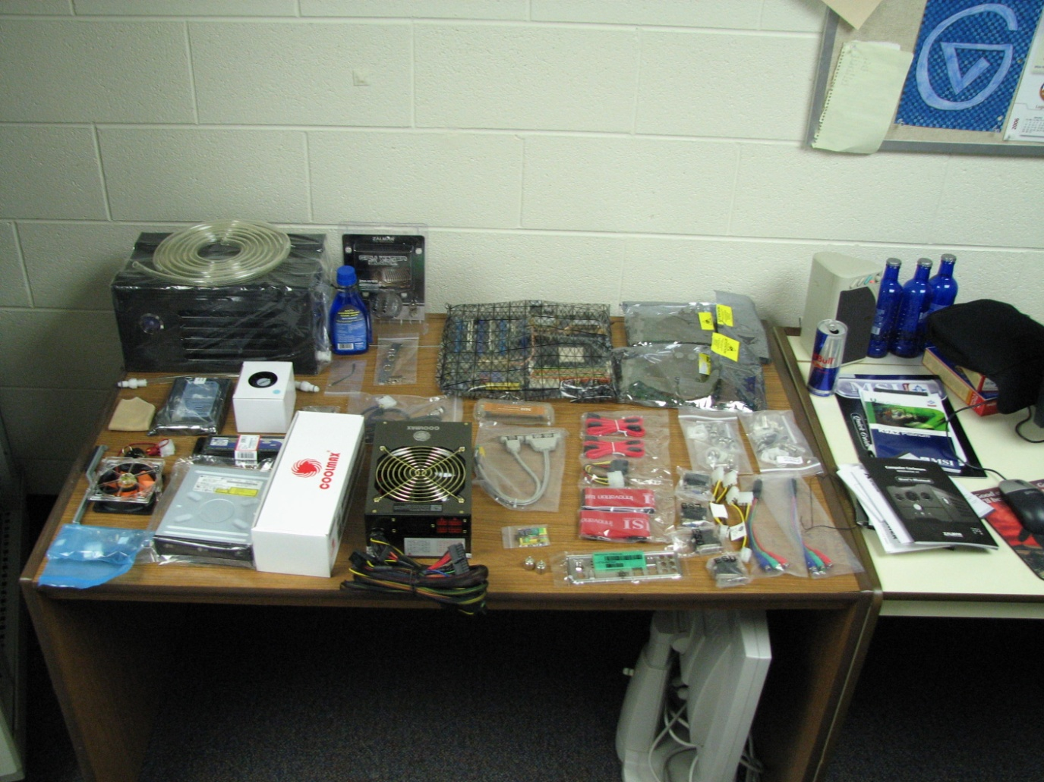
Hardware Requirements
CUDA-capable video card
Power supply
Cooling
PCI-Express

Slide 27
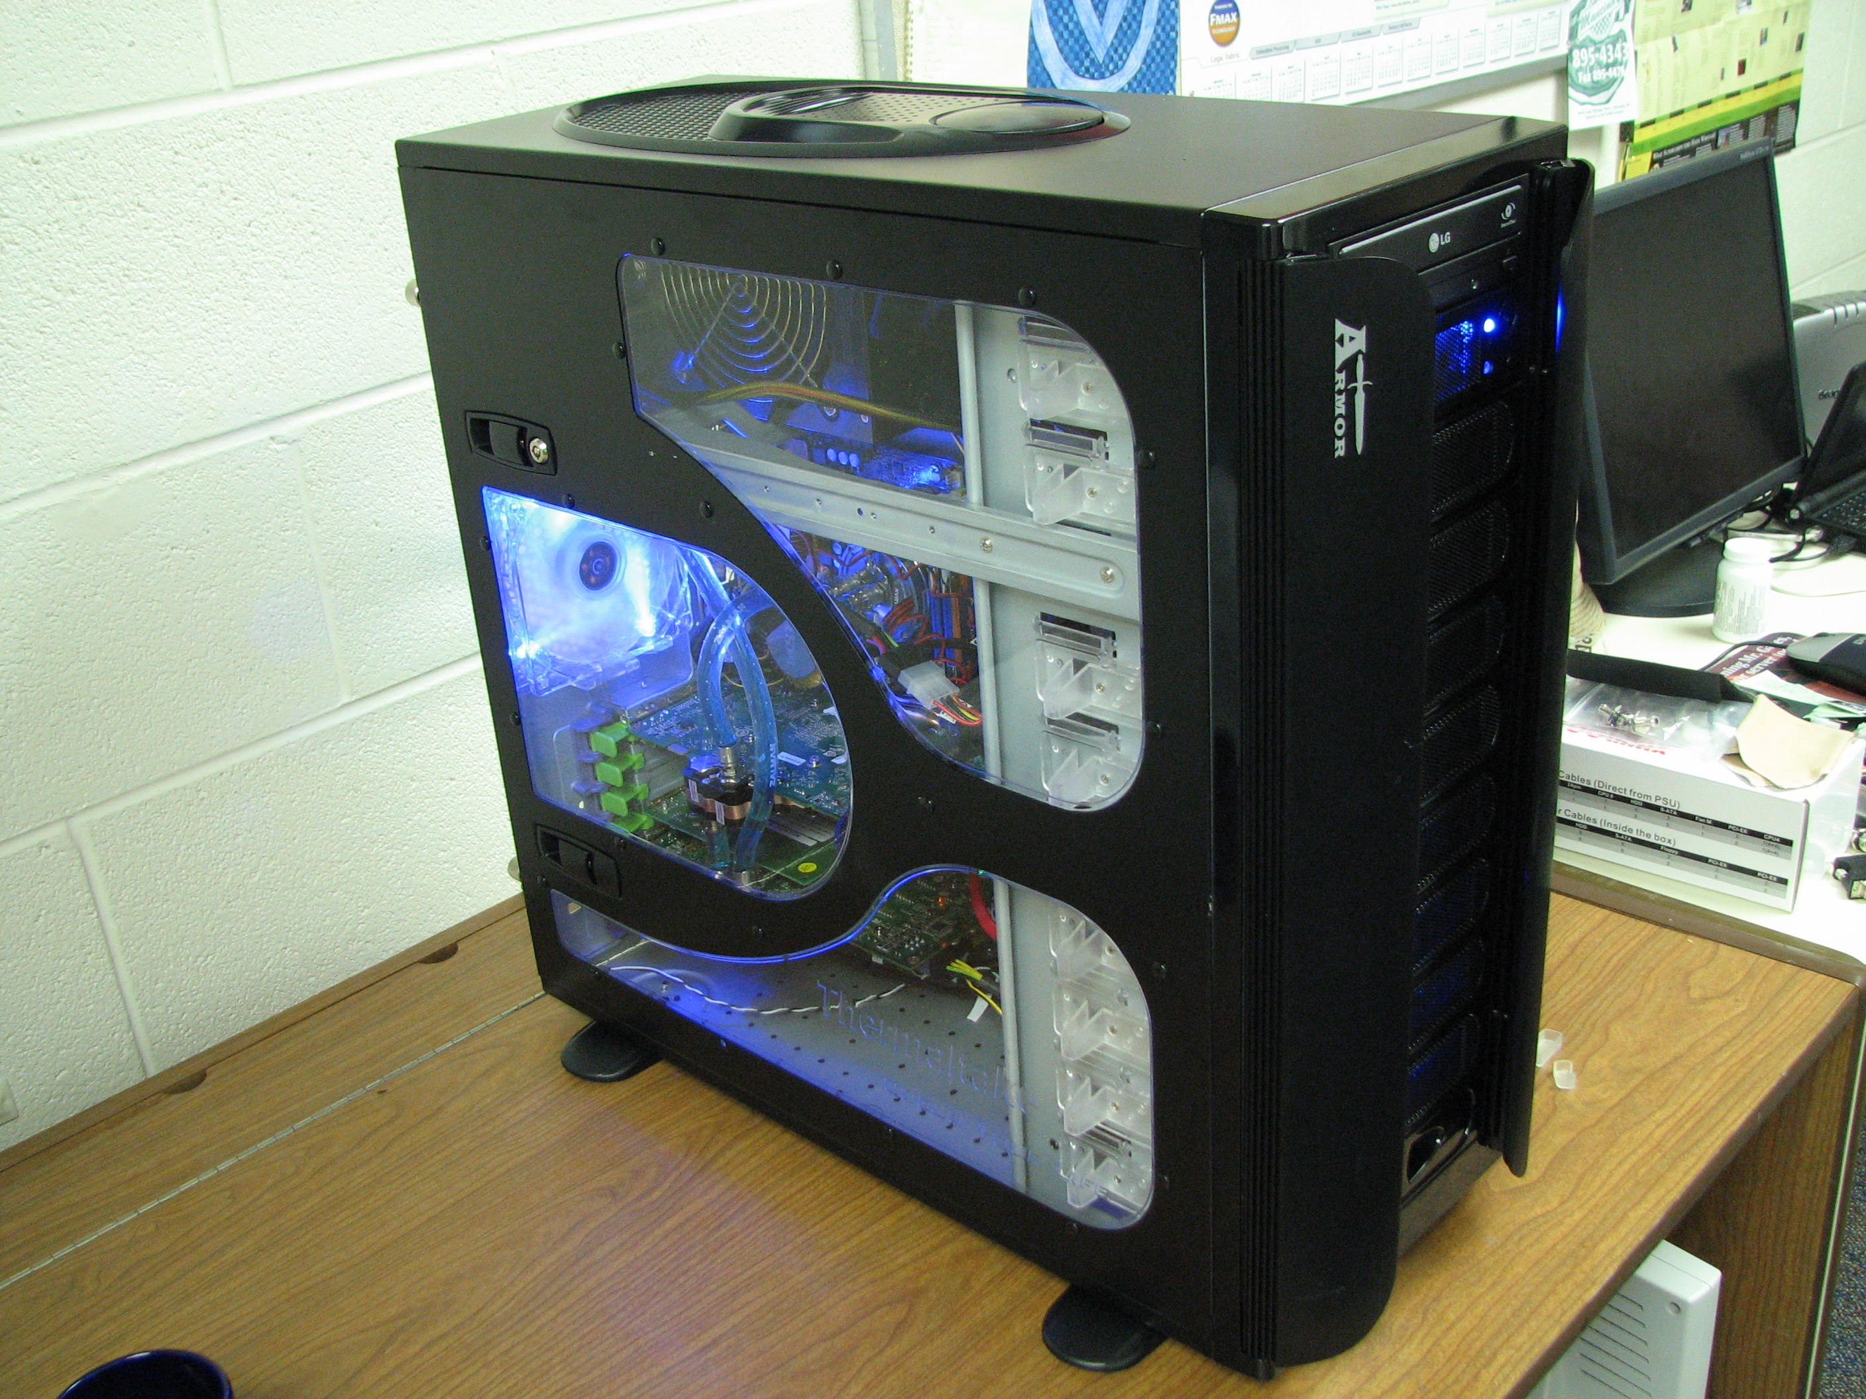

Slide 28
Acknowledgements
NVidia Corporation
developer.nvidia.com/CUDA
NVidia
Technical Brief – Architecture Overview
CUDA Programming Guide
ACM Queue
http://www.acmqueue.org/

Slide 29
A Gentle Introduction to CUDA Programming
Notes:
29

Slide 30
Credits
The code used in this presentation is based on code available in:
the Tutorial on CUDA in Dr. Dobbs Journal
Andrew Bellenir’s code for matrix multiplication
Igor Majdandzic’s code for Voronoi diagrams
NVIDIA’s CUDA programming guide
Notes:
30

Slide 31
Software Requirements/Tools
CUDA device driver
CUDA Software Development Kit
Emulator
CUDA Toolkit
Occupancy calculator
Visual profiler

Slide 32
To compute, we need to:
Allocate memory that will be used for the computation (variable declaration and allocation)
Read the data that we will compute on (input)
Specify the computation that will be performed
Write to the appropriate device the results (output)

Slide 33
A GPU is a specialized computer
We need to allocate space in the video card’s memory for the variables.
The video card does not have I/O devices, hence we need to copy the input data from the memory in the host computer into the memory in the video card, using the variable allocated in the previous step.
We need to specify code to execute.
Copy the results back to the memory in the host computer.

Slide 34
Initially:
Host’s Memory
GPU Card’s Memory
array

Slide 35
Allocate Memory in the GPU card
Host’s Memory
GPU Card’s Memory
array
array_d

Slide 36
Copy content from the host’s memory to the GPU card memory
Host’s Memory
GPU Card’s Memory
array
array_d

Slide 37
Execute code on the GPU
GPU MPs
Host’s Memory
GPU Card’s Memory
array
array_d

Slide 38
Copy results back to the host memory
Host’s Memory
GPU Card’s Memory
array
array_d

Slide 39

The Kernel
It is necessary to write the code that will be executed in the stream processors in the GPU card
That code, called the kernel, will be downloaded and executed, simultaneously and in lock-step fashion, in several (all?) stream processors in the GPU card
How is every instance of the kernel going to know which piece of data it is working on?
Notes:
39

Slide 40
Grid Size and Block Size
Programmers need to specify:
The grid size: The size and shape of the data that the program will be working on
The block size: The block size indicates the sub-area of the original grid that will be assigned to an MP (a set of stream processors that share local memory)
Notes:
40

Slide 41
Block Size
Recall that the “stream processors” of the GPU are organized as MPs (multi-processors) and every MP has its own set of resources:
Registers
Local memory
The block size needs to be chosen such that there are enough resources in an MP to execute a block at a time.

Slide 42
In the GPU:
Processing Elements
Array Elements
Block 0
Block 1

Slide 43
Let’s look at a very simple example
The code has been divided into two files:
simple.c
simple.cu
simple.c is ordinary code in C
It allocates an array of integers, initializes it to values corresponding to the indices in the array and prints the array.
It calls a function that modifies the array
The array is printed again.
Notes:
43

Slide 44
simple.c
#include <stdio.h> #define SIZEOFARRAY 64 extern void fillArray(int *a,int size); /* The main program */ int main(int argc,char *argv[]) { /* Declare the array that will be modified by the GPU */ int a[SIZEOFARRAY]; int i; /* Initialize the array to 0s */ for(i=0;i < SIZEOFARRAY;i++) { a[i]=i; } /* Print the initial array */ printf("Initial state of the array:\n"); for(i = 0;i < SIZEOFARRAY;i++) { printf("%d ",a[i]); } printf("\n"); /* Call the function that will in turn call the function in the GPU that will fill the array */ fillArray(a,SIZEOFARRAY); /* Now print the array after calling fillArray */ printf("Final state of the array:\n"); for(i = 0;i < SIZEOFARRAY;i++) { printf("%d ",a[i]); } printf("\n"); return 0; }
Notes:
44

Slide 45
simple.cu
simple.cu contains two functions
fillArray(): A function that will be executed on the host and which takes care of:
Allocating variables in the global GPU memory
Copying the array from the host to the GPU memory
Setting the grid and block sizes
Invoking the kernel that is executed on the GPU
Copying the values back to the host memory
Freeing the GPU memory
Notes:
45

Slide 46
fillArray (part 1)
#define BLOCK_SIZE 32
extern "C" void fillArray(int *array,int arraySize){
/* a_d is the GPU counterpart of the array that exists on the host memory */
int *array_d;
cudaError_t result;
/* allocate memory on device */
/* cudaMalloc allocates space in the memory of the GPU card */
result = cudaMalloc((void**)&array_d,sizeof(int)*arraySize);
/* copy the array into the variable array_d in the device */
/* The memory from the host is being copied to the corresponding variable in the GPU global memory */
result = cudaMemcpy(array_d,array,sizeof(int)*arraySize,
cudaMemcpyHostToDevice);
Notes:
46

Slide 47
fillArray (part 2)
/* execution configuration... */
/* Indicate the dimension of the block */
dim3 dimblock(BLOCK_SIZE);
/* Indicate the dimension of the grid in blocks */
dim3 dimgrid(arraySize/BLOCK_SIZE);
/* actual computation: Call the kernel, the function that is */
/* executed by each and every processing element on the GPU card */
cu_fillArray<<<dimgrid,dimblock>>>(array_d);
/* read results back: */
/* Copy the results from the GPU back to the memory on the host */
result = cudaMemcpy(array,array_d,sizeof(int)*arraySize,cudaMemcpyDeviceToHost);
/* Release the memory on the GPU card */
cudaFree(array_d);
}
Notes:
47

Slide 48
simple.cu (cont.)
The other function in simple.cu is
cu_fillArray()
This is the kernel that will be executed in every stream processor in the GPU
It is identified as a kernel by the use of the keyword: __global__
This function uses the built-in variables
blockIdx.x and
threadIdx.x
to identify a particular position in the array
Notes:
48

Slide 49
cu_fillArray
__global__ void cu_fillArray(int *array_d){
int x;
/* blockIdx.x is a built-in variable in CUDA
that returns the blockId in the x axis
of the block that is executing this block of code
threadIdx.x is another built-in variable in CUDA
that returns the threadId in the x axis
of the thread that is being executed by this
stream processor in this particular block
*/
x=blockIdx.x*BLOCK_SIZE+threadIdx.x;
array_d[x]+=array_d[x];
}
Notes:
49

Slide 50
To compile:
nvcc simple.c simple.cu –o simple
The compiler generates the code for both the host and the GPU
Demo on cuda.littlefe.net …
Notes:
50

Slide 51
What are those blockIds and threadIds?
With a minor modification to the code, we can print the blockIds and threadIds
We will use two arrays instead of just one.
One for the blockIds
One for the threadIds
The code in the kernel:
x=blockIdx.x*BLOCK_SIZE+threadIdx.x;
block_d[x] = blockIdx.x;
thread_d[x] = threadIdx.x;
Notes:
51

Slide 52
In the GPU:
Thread 0
Thread 1
Thread 2
Thread 3
Thread 0
Thread 1
Thread 2
Thread 3
Block 0
Block 1
Processing Elements
Array Elements

Slide 53
Hands-on Activity
Compile with (one single line)
nvcc blockAndThread.c blockAndThread.cu
-o blockAndThread
Run the program
./blockAndThread
Edit the file blockAndThread.cu
Modify the constant BLOCK_SIZE. The current value is 8, try replacing it with 4.
Recompile as above
Run the program and compare the output with the previous run.

Slide 54
This can be extended to 2 dimensions
See files:
blockAndThread2D.c
blockAndThread2D.cu
The gist in the kernel
x = blockIdx.x*BLOCK_SIZE+threadIdx.x;
y = blockIdx.y*BLOCK_SIZE+threadIdx.y;
pos = x*sizeOfArray+y;
block_dX[pos] = blockIdx.x;
Compile and run blockAndThread2D
nvcc blockAndThread2D.c blockAndThread2D.cu
-o blockAndThread2D
./blockAndThread2D

Slide 55
When the kernel is called:
dim3 dimblock(BLOCK_SIZE,BLOCK_SIZE);
nBlocks = arraySize/BLOCK_SIZE;
dim3 dimgrid(nBlocks,nBlocks);
cu_fillArray<<<dimgrid,dimblock>>>
(… params…);

Slide 56
Another Example: saxpy
SAXPY (Scalar Alpha X Plus Y)
A common operation in linear algebra
CUDA: loop iteration ⇨ thread

Slide 57
Traditional Sequential Code
void saxpy_serial(int n,
float alpha,
float *x,
float *y)
{
for(int i = 0;i < n;i++)
y[i] = alpha*x[i] + y[i];
}

Slide 58
CUDA Code
__global__ void saxpy_parallel(int n,
float alpha,
float *x,
float *y) {
int i = blockIdx.x*blockDim.x+threadIdx.x;
if (i<n)
y[i] = alpha*x[i] + y[i];
}

Slide 59
Keeping Multiprocessors in mind…
Each hardware multiprocessor has the ability to actively process multiple blocks at one time.
How many depends on the number of registers per thread and how much shared memory per block is required by a given kernel.
The blocks that are processed by one multiprocessor at one time are referred to as “active”.
If a block is too large, then it will not fit into the resources of an MP.

Slide 60
“Warps”
Each active block is split into SIMD ("Single Instruction Multiple Data") groups of threads called "warps".
Each warp contains the same number of threads, called the "warp size", which are executed by the multiprocessor in a SIMD fashion.
On “if” statements, or “while” statements (control transfer) the threads may diverge.
Use: __syncthreads()

Slide 61

A Real Application
The Voronoi Diagram: A fundamental data structure in Computational Geometry

Slide 62
Definition
Definition : Let S be a set of n sites in Euclidean space of dimension d. For each site p of S, the Voronoi cell V(p) of p is the set of points that are closer to p than to other sites of S. The Voronoi diagram V(S) is the space partition induced by Voronoi cells.

Slide 63
Algorithms
The classical sequential algorithm has complexity O(n log n) where n is the number of sites (seeds).
If one only needs an approximation, on a grid of points (e.g. digital display):
Assign a different color to each seed
Calculate the distance from every point in the grid to all seeds
Color each point with the color of its closest seed

Slide 64
Lends itself to implementation on a GPU…
The calculation for every pixel is a good candidate to be carried out in parallel…
Notice that the locations of the seeds are read-only in the kernel
Thus we can use the texture map area in the GPU card, which is a fast read-only cache to store the seeds:
__device__ __constant__ …

Slide 65
Demo on cuda…

Slide 66
Tips for improving performance
Special thanks to Igor Majdandzic.

Slide 67
Memory Alignment
Memory access on the GPU works much better if the data items are aligned at 64 byte boundaries.
Hence, allocating 2D arrays so that every row starts at a 64-byte boundary address will improve performance.
But that is difficult to do for a programmer

Slide 68
Allocating 2D arrays with “pitch”
CUDA offers special versions of:
Memory allocation of 2D arrays so that every row is padded (if necessary). The function determines the best pitch and returns it to the program. The function name is cudaMallocPitch()
Memory copy operations that take into account the pitch that was chosen by the memory allocation operation. The function name is cudaMemcpy2D()

Slide 69
Pitch
Columns
Padding
Rows
Pitch

Slide 70
A simple example:
See pitch.cu
A matrix of 30 rows and 10 columns
The work is divided into 3 blocks of 10 rows:
Block size is 10
Grid size is 3

Slide 71
Key portions of the code (1)
result = cudaMallocPitch(
(void **)&devPtr,
&pitch,
width*sizeof(int),
height);

Slide 72
Key portions of the code (2)
result = cudaMemcpy2D(
devPtr,
pitch,
mat,
width*sizeof(int),
width*sizeof(int),
height,
cudaMemcpyHostToDevice);

Slide 73
In the kernel:
\
__global__ void myKernel(int *devPtr,
int pitch,
int width,
int height)
{
int c;
int thisRow;
thisRow = blockIdx.x * 10 + threadIdx.x;
int *row = (int *)((char *)devPtr + thisRow*pitch);
for(c = 0;c < width;c++)
row[c] = row[c] + 1;
}

Slide 74
The call to the kernel
myKernel<<<3,10>>>(
devPtr,
pitch,
width,
height);

Slide 75
pitch ⇨ Divide work by rows
Notice that when using pitch, we divide the work by rows.
Instead of using the 2D decomposition of 2D blocks, we are dividing the 2D matrix into blocks of rows.

Slide 76
Dividing the work by blocks:
Columns
Block 0
Rows
Block 1
Block 2
Pitch

Slide 77

An application that uses pitch: Mandelbrot
The Mandelbrot set: A set of points in the complex plane, the boundary of which forms a fractal.
A complex number, c, is in the Mandelbrot set if, when starting with x₀=0 and applying the iteration
x_{n+1} = x_{n}² + c
repeatedly, the absolute value of x_{n} never exceeds a certain number (that number depends on c) however large n gets.

Slide 78
Demo: Comparison
We can compare the execution times of:
The sequential version
The CUDA version

Slide 79
Performance Tip: Block Size
Critical for performance
Recommended value is 192 or 256
Maximum value is 512
Should be a multiple of 32 since this is the warp size for Series 8 GPUs and thus the native execution size for multiprocessors
Limited by number of registers on the MP
Series 8 GPU MPs have 8192 registers which are shared between all the threads on an MP

Slide 80
Performance Tip: Grid Size
Critical for scalability
Recommended value is at least 100, but 1000 would scale for many generations of hardware
Actual value depends on size of the problem data
It should be a multiple of the number of MPs for an even distribution of work (not a requirement though)
Example: 24 blocks
Grid will work efficiently on Series 8 (12 MPs), but it will waste resources on new GPUs with 32MPs

Slide 81
Performance Tip: Code Divergance
Control flow instructions diverge (threads take different paths of execution)
Example: if, for, while
Diverged code prevents SIMD execution – it forces serial execution (kills efficiency)
One approach is to invoke a simpler kernel multiple times
Liberal use of __syncthreads()

Slide 82
Performance Tip: Memory Latency
4 clock cycles for each memory read/write plus additional 400-600 cycles for latency
Memory latency can be hidden by keeping a large number of threads busy
Keep number of threads per block (block size) and number of blocks per grid (grid size) as large as possible
Constant memory can be used for constant data (variables that do not change).
Constant memory is cached.

Slide 83
Performance Tip: Memory Reads
Device is capable of reading a 32, 64 or 128-bit number from memory with a single instruction
Data has to be aligned in memory (this can be accomplished by using cudaMallocPitch() calls)
If formatted properly, multiple threads from a warp can each receive a piece of memory with a single read instruction

Slide 84
Watchdog timer
Operating system GUI may have a "watchdog" timer that causes programs using the primary graphics adapter to time out if they run longer than the maximum allowed time.
Individual GPU program launches are limited to a run time of less than this maximum.
Exceeding this time limit usually causes a launch failure.
Possible solution: run CUDA on a GPU that is NOT attached to a display.

Slide 85
Resources on line
http://www.acmqueue.org/modules.php?name=Content&pa=showpage&pid=532
http://www.ddj.com/hpc-high-performance-computing/207200659
http://www.nvidia.com/object/cuda_home.html#
http://www.nvidia.com/object/cuda_learn.html
“Computation of Voronoi diagrams using a graphics processing unit” by Igor Majdandzic et al. available through IEEE Digital Library, DOI: 10.1109/EIT.2008.4554342
Notes:
85

